Slide 1


Zomato Insights Hyderabad: Leveraging Sentiment Analysis and Clustering for Improved Restaurant Recommendations and Boost Business Growth
UNDER THE GUIDANCE OF
Dr. B. RAJESWARI
ASSOCIATE PROFESSOR
DEPARTMENT OF MANAGEMENT STUDIES
PONDICHERRY UNIVERSITY
Presented by
RAMESH KUMAR . M
REG. NO: 21401031
MBA(DA)-2nd YEAR

Slide 2
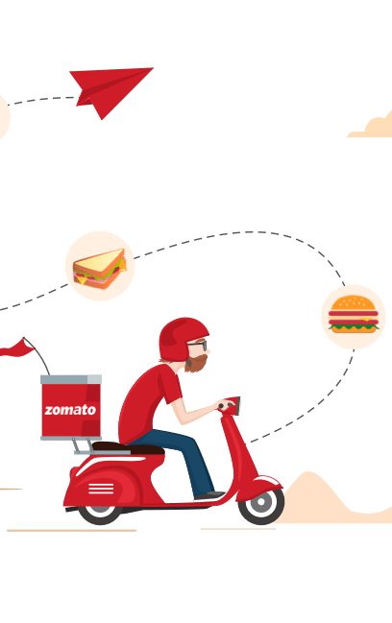
CONTENTS
01 – Company overview
02 – Objective
03 – Dataset
04 – Exploratory data analysis
05 – Modelling
06 – Conclusion

Slide 3

COMPANY OVERVIEW
Brightpoint Infotech is a leading Enterprise & Business Solutions consulting firm headquartered at Fort Lauderdale, Florida.
Brightpoint Infotech is an Asian-American minority-owned firm and, is a Microsoft Dynamics Gold Certified Partner & Direct Microsoft Cloud Solution Provider (CSP).
Brightpoint Infotech is a prestigious member of the select few clubs of CSP and is authorized to sell Microsoft Dynamics & Cloud products & solutions across the globe.
Brightpoint Infotech has a short but a rich legacy of over 15+ years in implementing Dynamics ERP and CRM solutions for small and medium enterprises. The exemplary leadership of Brightpoint Infotech has set a vision to be a Top 10 Microsoft Dynamics Consulting partner within 3 years.

Slide 4
Objective
The main objective of this project is to leverage sentiment analysis and clustering techniques to provide improved restaurant recommendations to customers on the Zomato platform, as well as to help the company identify areas for improvement and growth in their business strategies. Specifically, the project aims to:
Develop and apply sentiment analysis algorithms to extract and analyse the opinions, attitudes, and emotions expressed in Zomato user reviews.
Use clustering algorithms to group Zomato restaurants based on shared characteristics, such as cuisine, price range, location, and customer ratings.
Utilize the results of sentiment analysis and clustering to generate personalized restaurant recommendations for Zomato users, and to identify areas where the company can improve its offerings and business strategies.

Slide 5
DATASet
In this project, the real-world datasets provided by Brightpoint Infotech Pt. Ltd.
Zomato Restaurant reviews:
Restaurant : Name of the Restaurant
Reviewer : Name of the Reviewer
Review : Review Text
Rating : Rating Provided by Reviewer
Metadata : Reviewer Metadata- No. of Reviews and followers
Time : Date and Time of Review
Pictures : No. of pictures posted with review
Zomato Restaurant names and Metadata:
Name : Name of Restaurants
Links : URL Links of Restaurants
Cost : Per person estimated Cost of dining
Collection : Tagging of Restaurants with respect to Zomato categories
Cuisines : Cuisines served by Restaurants
Timings : Restaurant Timings

Slide 6
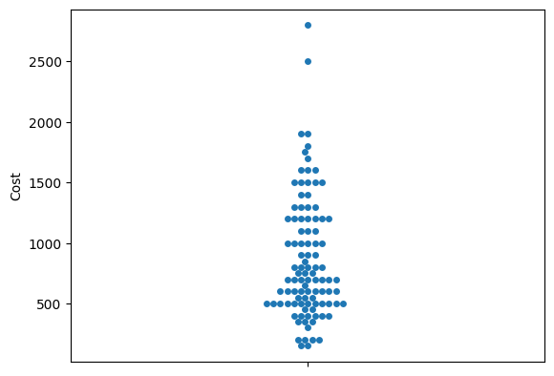
EDA
1. To find the cost of restaurants:
It is clearly visible that average cost per person in restaurants varies from below 500 to more than 2500. But there are too few restaurants whose price is more than 2000. Let's find out more about Restaurant prices.

Slide 7
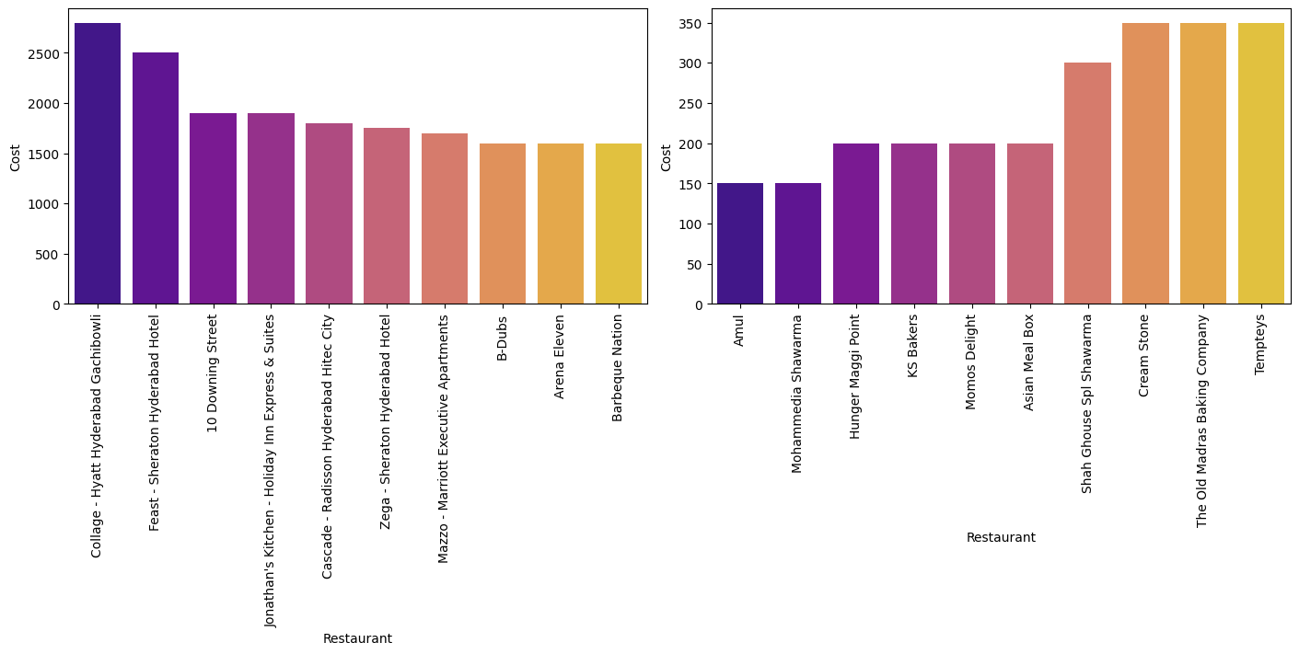
EDA
2. To visualize which are the expensive restaurants and which are the cheap restaurants on Zomato
Expensive Restaurants: Here "Collage - Hyatt Hyderabad Gachibowli" is the most expensive restaurant whose price is rupees 2800 which is followed by "Feast - Sheraton Hyderabad Hotel" whose price is rupees 2500. Other expensive restaurants can be seen from the graph and table.
Cheap Restaurants: Here "Mohammedia Shawarma" and "Amul" is the cheapest restaurant where we can get the dish with the minimum price of rupees 150, which is followed by "Sweet Basket", "KS Bakers", "Momos Delight etc whose price is rupees 200.

Slide 8
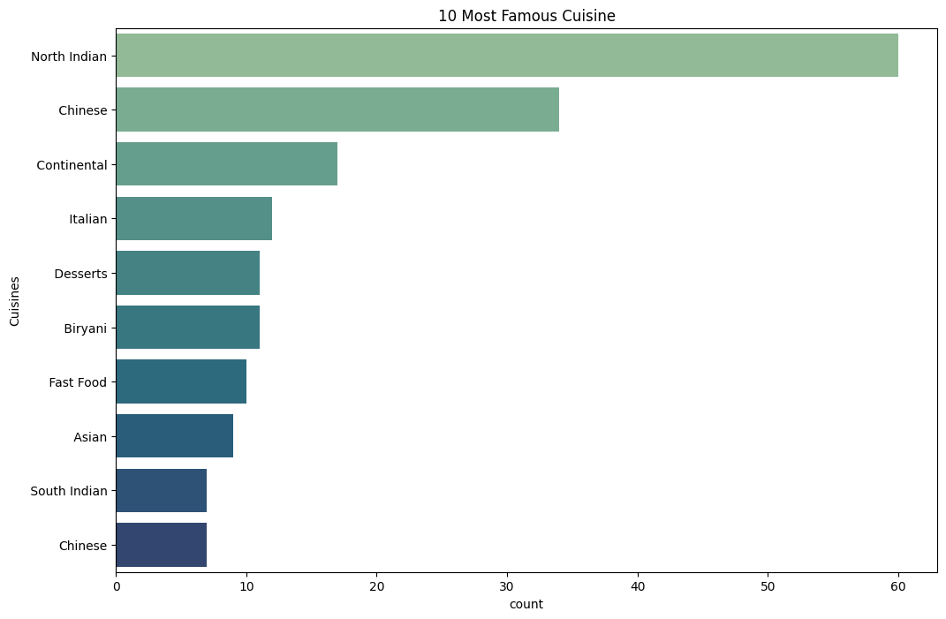
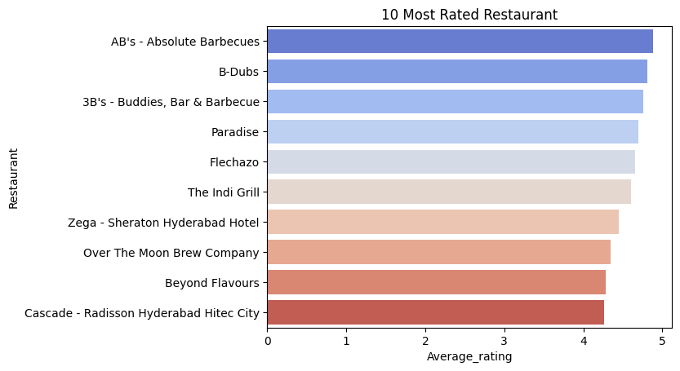
EDA
3. Bar graph is used because of categorical features:
4. To see the top 10 restaurants having highest average rating:
It is clearly visible that North Indian is the most served cuisine in restaurants which is followed by Chinese and Continental.
Here AB's - Absolute Barbecues is the top average rated restaurant followed by B-Dubs and 3B's - Buddies, Bar and Barbeque.

Slide 9
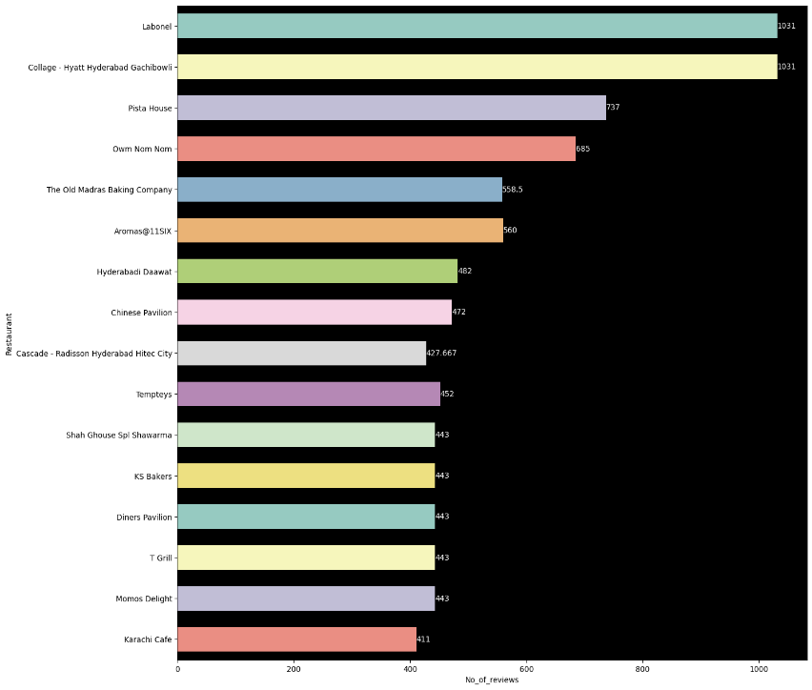
EDA
5. To see the count of review for restaurants given in each year and each hour:
Here Labonel and Collage - Hyatt Hyderabad Gachibowli (which is also the most expensive) are given he maximum number of reviews with the count of 1031 (which is really a good figure).

Slide 10
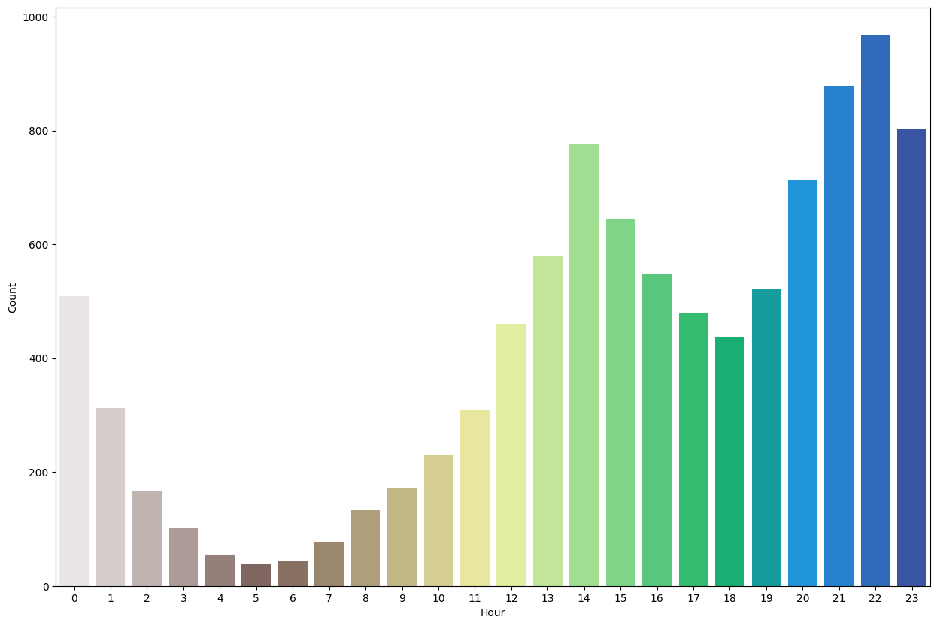
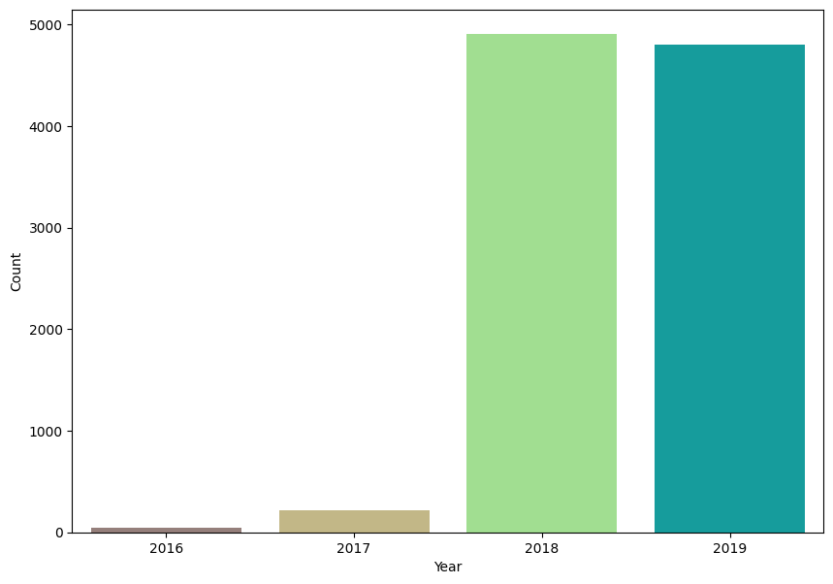
EDA
6. To see the count of review for restaurants given in each year and each hour:
Hour: The frequency is higher during the night time from hour 19 to 22, i.e., from 7:00 pm to 11:00 pm. Possibly because people mostly order food during these hours.
Year: The frequency is minimum in the year 2016 while its maximum in the year 2019. It is possible due to the fact that there is improvement in technology and people getting familiar with new applications and online system.

Slide 11
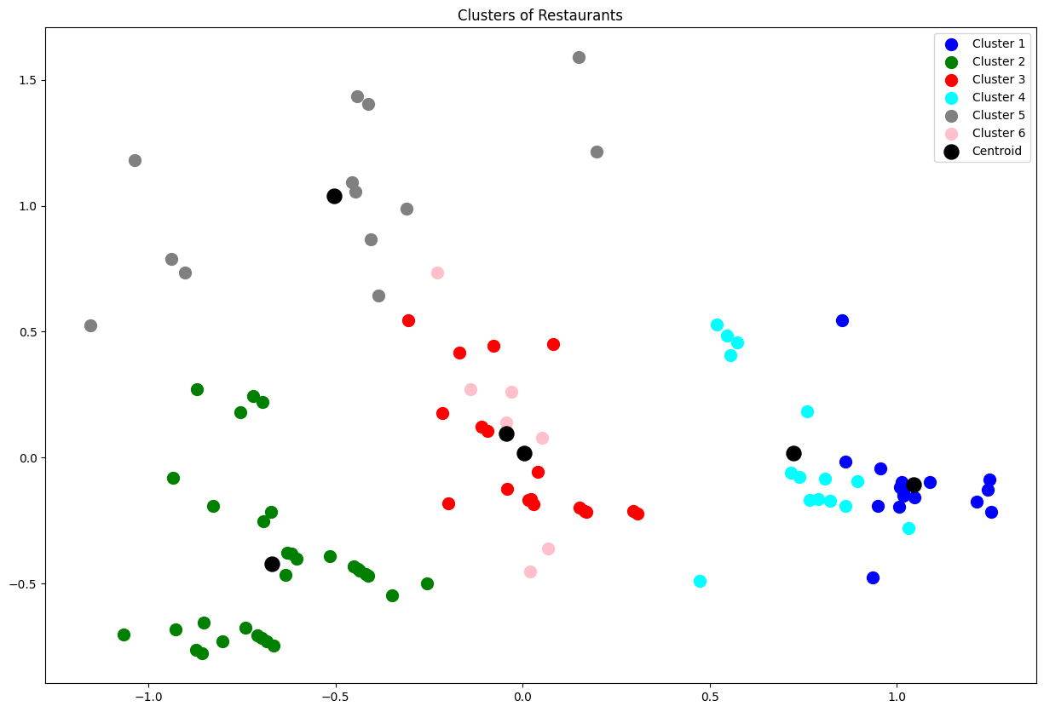
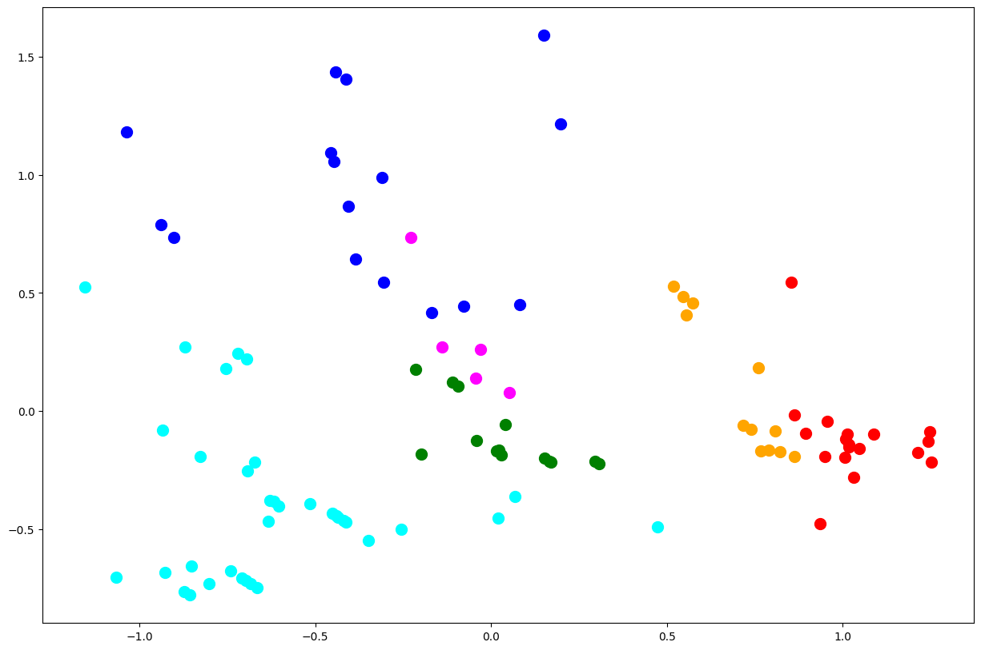
ModelLing
ML Model - 1 : CLUSTERING
ML Model - 2: HIERARCHICAL CLUSTERING
The Clustering Model has helped in grouping restaurants based on the other attributes of the restaurants, which will ultimately aid the company in developing Targeted Revenue-Boosting measures.

Slide 12
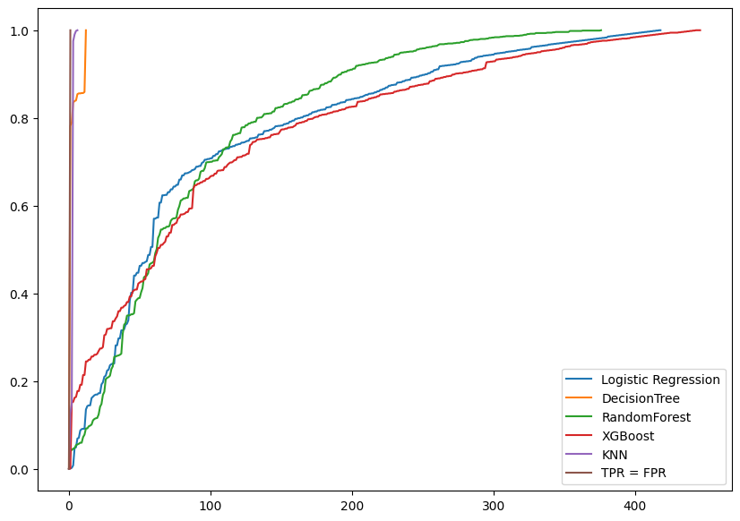
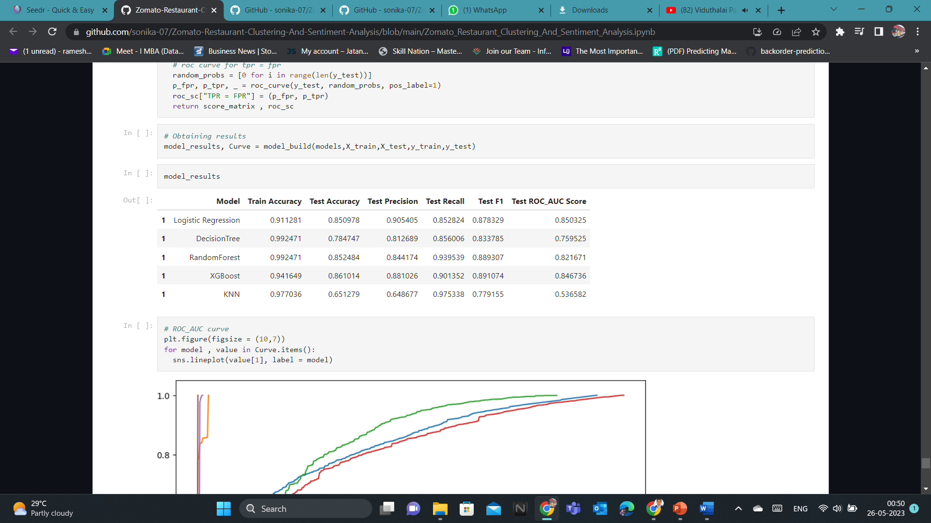
ModelLing
ML Model - 3: SENTIMENTAL ANALYSIS
The sentiment analysis model has helped the business in classifying the positive and negative reviews of the customers. Now that the company is aware of the restaurant inadequacies described in the unfavorable reviews, they may work to improve their business position.

Slide 13
conclusion
Clustering and sentiment analysis were performed on a dataset of customer reviews for the food delivery service Zomato. The purpose of this analysis was to understand the customer's experience and gain insights about their feedback.
The proposed project has the potential to benefit both customers and the company. Customers can use the insights generated from sentiment analysis and clustering to make informed decisions about where to eat, while the company can use the insights to identify areas of improvement, tailor their business strategies, and ultimately improve their overall performance.
Overall, the proposed project can contribute to the field of restaurant recommendation systems and business analytics by leveraging advanced techniques such as sentiment analysis and clustering to provide insights that can drive improved decision-making.

Slide 14


